Slide 1
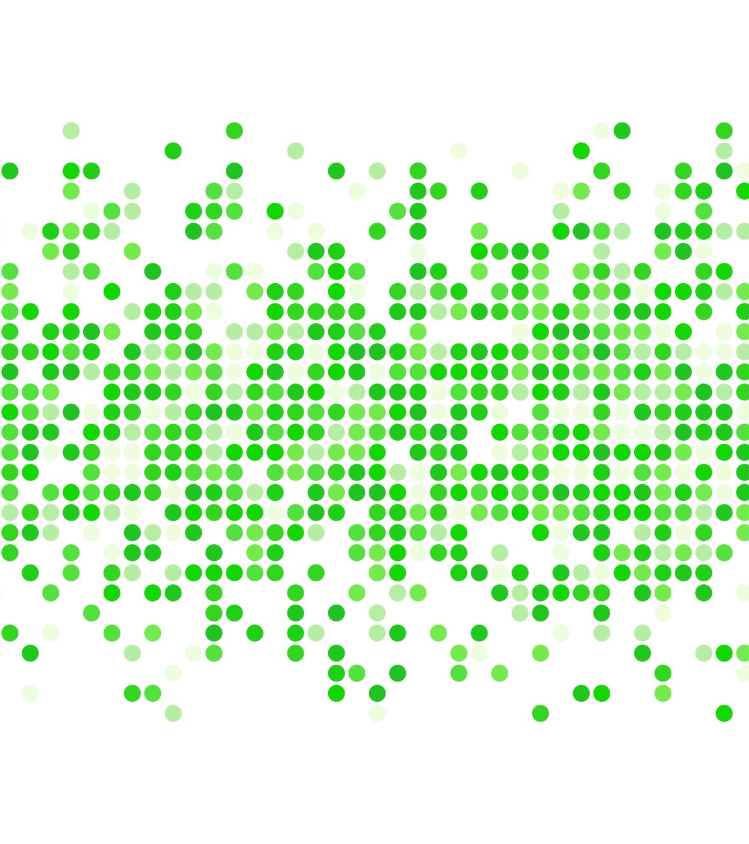
Web Application Security
Finding summarize

Slide 2
OWASP Juice Shop
OWASP Juice Shop is an intentionally insecure web application created by the Open Web Application Security Project (OWASP) to teach developers, security professionals, and students about web security issues. It includes vulnerabilities covering the OWASP Top 10 and beyond, providing a realistic environment to practice finding and exploiting security vulnerabilities.

Slide 3
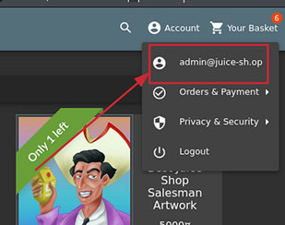
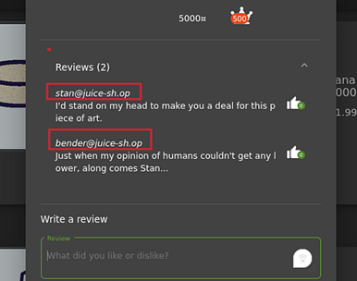
First vulnerability
Login is vulnerable to SQL injection.
Recommendation : Use parameterized queries to prevent SQL injection in the login functionality.

Slide 4
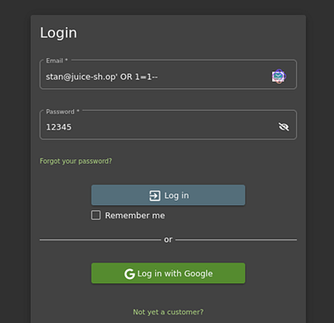
Second Vulnerbility
Some User login is also vulnerable to SQL injection, but it grants admin access instead of the targeted user account.
Recommendation : Implement input validation and use parameterized queries to prevent SQL injection that can grant admin access.

Slide 5
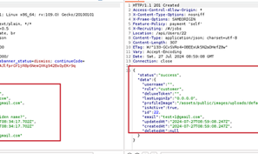
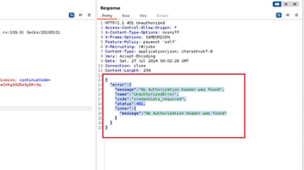
Third Vulnerability
The system permits using the same email address for both the username and password, compromising account security.
I went back to Burp Suite and noticed a POST request to /api/Users/. Curious, I sent it to the Repeater, removed the POST body, changed the request to GET, and sent it. I received a response error:
{
"error": {
"message": "No Authorization header was found",
"name": "UnauthorizedError",
"code": "credentials_required",
"status": 401,
"inner": {
"message": "No Authorization header was found"
}
}
}
Recommendation : Enforce distinct and strong passwords that differ from the email address to enhance account security.

Slide 6
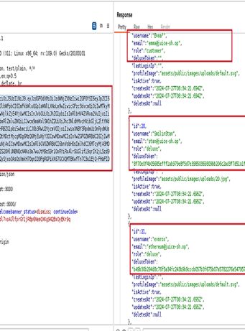

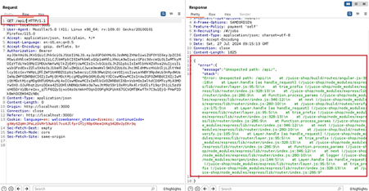
Fourth Vulnerability
PII disclosure due to improper authorization checks.
Note: Normal user authorization tokens also worked.
I made a request to /api/ after removing /Users/ from the endpoint, which triggered a stack error. I consider this a security issue.
Recommendation : Implement strict authorization checks to ensure only authorized users can access Personally Identifiable Information (PII).

Slide 7
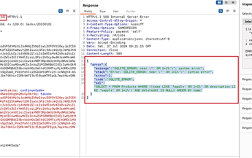
Fifth Vulnerability
Stack trace disclosure due to improper error handling.
I noticed a header GET /rest/products/search?q= and tried apple' OR 1=1. This triggered an error that revealed the database name and the location of the error.
{
"error": {
"message": "SQLITE_ERROR: near \"' OR 1=1%'\": syntax error",
"stack": "Error: SQLITE_ERROR: near \"' OR 1=1%'\": syntax error",
"errno": 1,
"code": "SQLITE_ERROR",
"sql": "SELECT * FROM Products WHERE ((name LIKE '%apple' OR 1=1%' OR description LIKE '%apple' OR 1=1%') AND deletedAt IS NULL) ORDER BY name"
}
}
Recommendation : Implement proper error handling to prevent stack trace disclosures in user-facing responses.

Slide 8
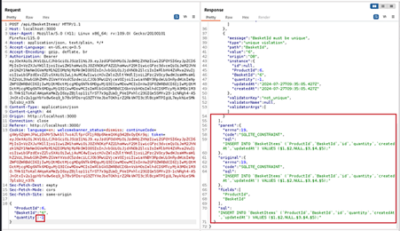
Sixth vulnerability
Information disclosure due to improper handling of SQL errors.
I triggered another error via the /api/BasketItems/ endpoint by inputting a value it didn't expect (e.g., -1). This revealed more information about the database.
Recommendation: Sanitize SQL error messages to prevent information disclosure.

Slide 9
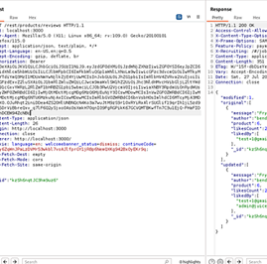
Seventh Vulnerbility
Information disclosure due to improper validation of user input.
I noticed that a normal user can’t view the users who liked a particular product. By changing the authorization header to that of an admin, I was able to get the emails of users who liked the product.
Recommendation: Implement robust input validation to prevent information disclosure.

Slide 10
Eighth vulnerability
Privilege escalation allowing unauthorized access to user emails. Recommendation: Implement strict access controls to prevent privilege escalation and unauthorized access to user emails

Slide 11
Thank you
Presented by : Kushagra Pitre
Date : 13/08/204
Contact : 9766695361
Email: kushagrapitre2@gmail.com
Intern : andintern

